Slide 1
JAVA Networking & JDBC

Slide 2
JAVA Networking
Java Networking is a concept of connecting two or more computing devices together so that we can share resources.
Java networking is the foundation for building networked applications. It allows programs to send and receive data over the network, and by using classes like Socket, ServerSocket, and others.
Java makes it relatively easy to implement communication between computers.

Slide 3
Sockets
A socket is a communication endpoint that allows data exchange between two devices on a network. It acts as a bridge between the application and the transport layer.
Types of Socket
Datagram Sockets: Datagram sockets allow processes to use the User Datagram Protocol (UDP). It is a two-way flow of communication or messages. The socket type of datagram socket is SOCK_DGRAM.
Stream Sockets: Stream socket allows processes to use the Transfer Control Protocol (TCP) for communication. A stream socket provides a sequenced, constant or reliable, and two-way (bidirectional) flow of data. The socket type of stream socket is SOCK_STREAM.

Slide 4
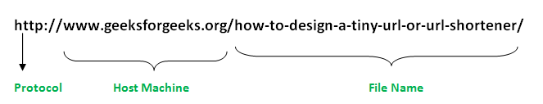
URL
URL known as Uniform Resource Locator is simply a string of text that identifies all the resources on the Internet, telling us the address of the resource, how to communicate with it, and retrieve something from it.

Slide 5
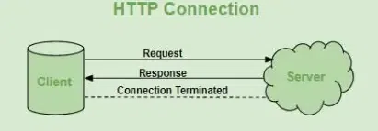
HTTP
HTTP (Hypertext Transfer Protocol) is a fundamental protocol of the Internet, enabling the transfer of data between a client and a server. It is the foundation of data communication for the World Wide Web.

Slide 6
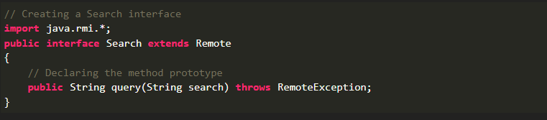
JAVA RMI
Remote Method Invocation (RMI) is an API that allows an object to invoke a method on an object that exists in another address space, which could be on the same machine or on a remote machine. Through RMI, an object running in a JVM present on a computer (Client-side) can invoke methods on an object present in another JVM (Server-side).

Slide 7
JDBC
JDBC stands for Java Database Connectivity. JDBC is a Java API to connect and execute the query with the database, and processing the results.
It enables you to execute SQL queries, retrieve results, and handle database errors.
Steps to Connect Java Application with Database
Step 1 – Import the Packages
Step 2 – Load the drivers using the forName() method
Step 3 – Register the drivers using DriverManager
Step 4 – Establish a connection using the Connection class object
Step 5 – Create a statement
Step 6 – Execute the query
Step 7 – Close the connections

Slide 8
CRUD
CRUD stands for Create, Read/Retrieve, Update and Delete and these are the four basic operations that we perform on persistence storage.
CRUD Operations
Create: This operation adds new records to a table using an INSERT SQL statement.
Read: This operation retrieves data from a table using a SELECT SQL statement.
Update: This operation modifies existing data in the table using an UPDATE SQL statement.
Delete: This operation removes records from a table using a DELETE SQL statement.

Slide 9
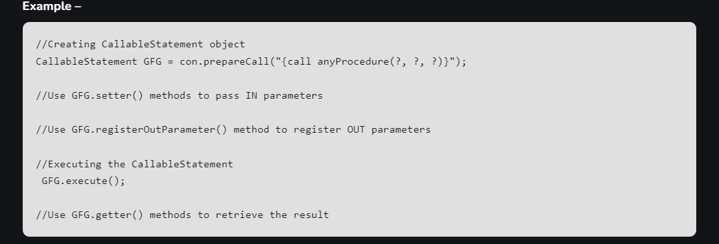
CallableStatement
It is used when you want to use the database stored procedures. CallableStatement can accept runtime input parameters.

Slide 10
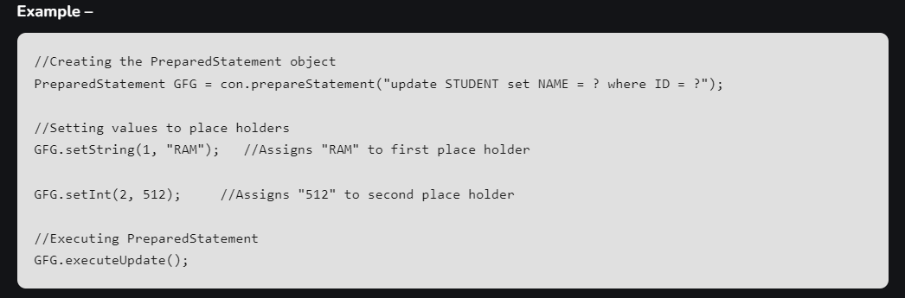
PreparedStatement
It is used when you want to use SQL statements many times. The PreparedStatement interface accepts input parameters at runtime.

Slide 11


